Slide 1
Agenda
Introduction
Data Cleaning
Baseline Method and Vectorization
Hypothesis Results
Model results
Conclusion

Slide 2

Introduction

Slide 3
Data
Kaggle: Real or Fake: Fake Job Description Prediction
Government census data
Kaggle: “US jobs on Monster.com” dataset
Synthetically generated data to be labelled as fake postings

Slide 4
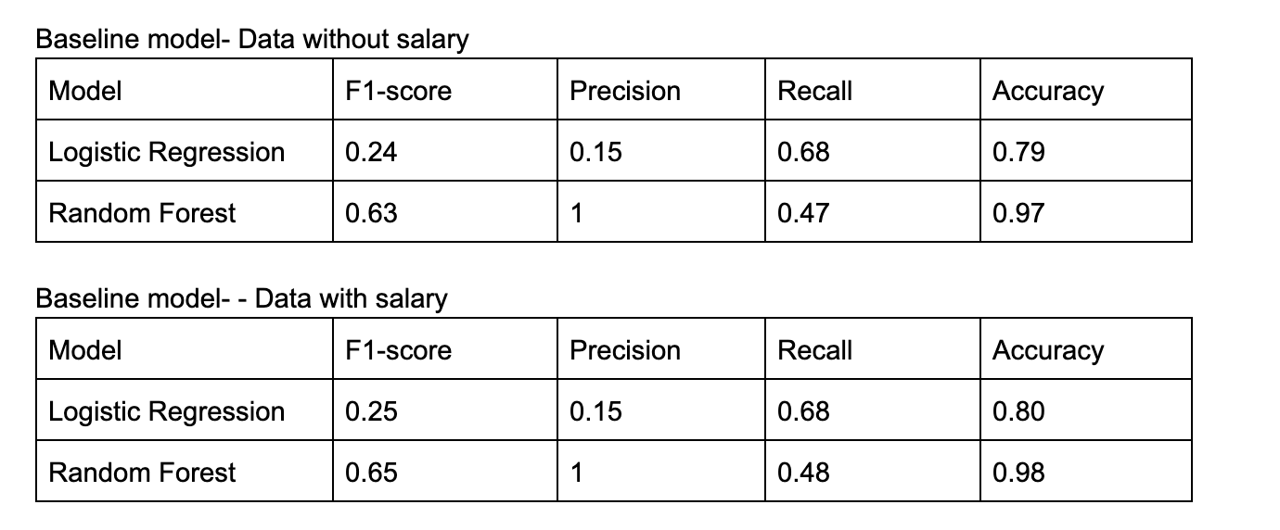
Baseline Model

Slide 5
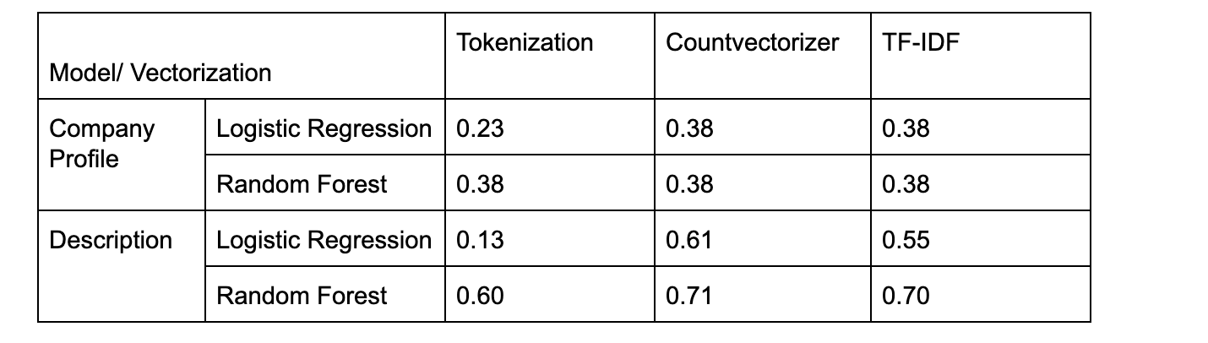
Vectorization

Slide 6
Hypothesis Results:
Whether generating fake postings would improve model performance.
Whether semi-supervised learning would improve model performance.

Slide 7
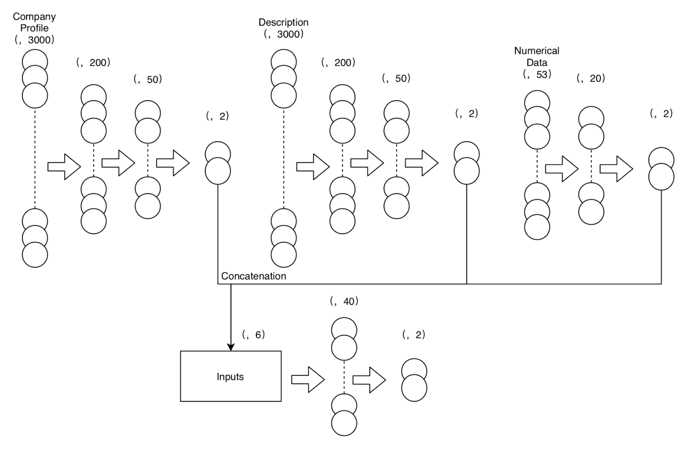
Model Results: NN Model

Slide 8
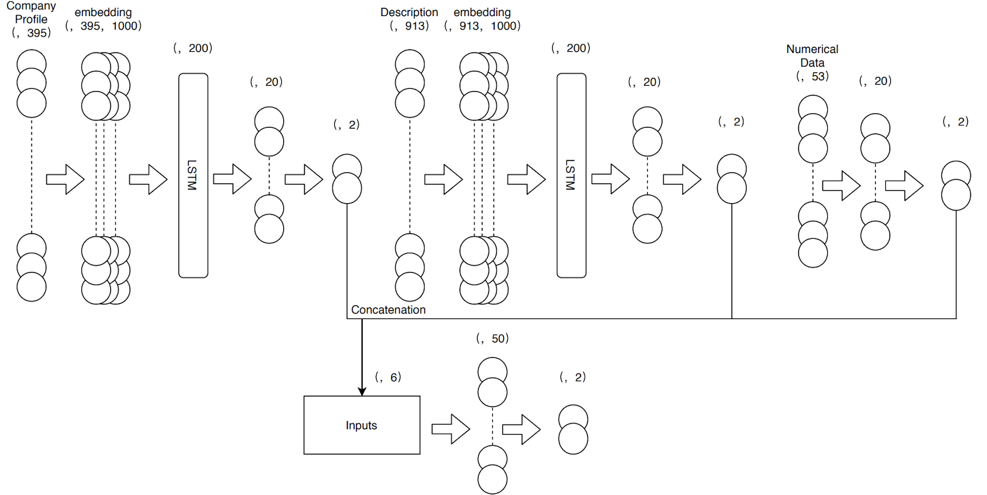
Model Results: NN LSTM Model

Slide 9
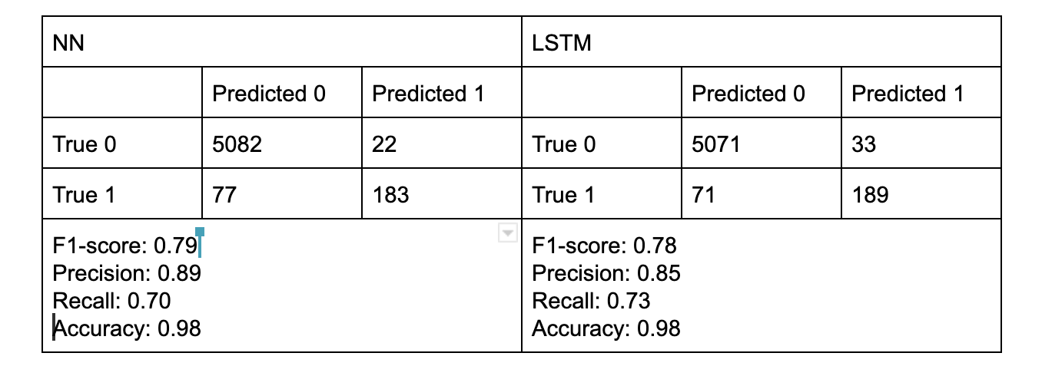
Result Comparison: NN vs NN LSTM

Slide 10
Conclusion
Conclusion
Future Study

